Slide 1
Pipelining w/ AWS
Markus Winkler
Cloud & DevOps Architect, 10/21/2020

Slide 2
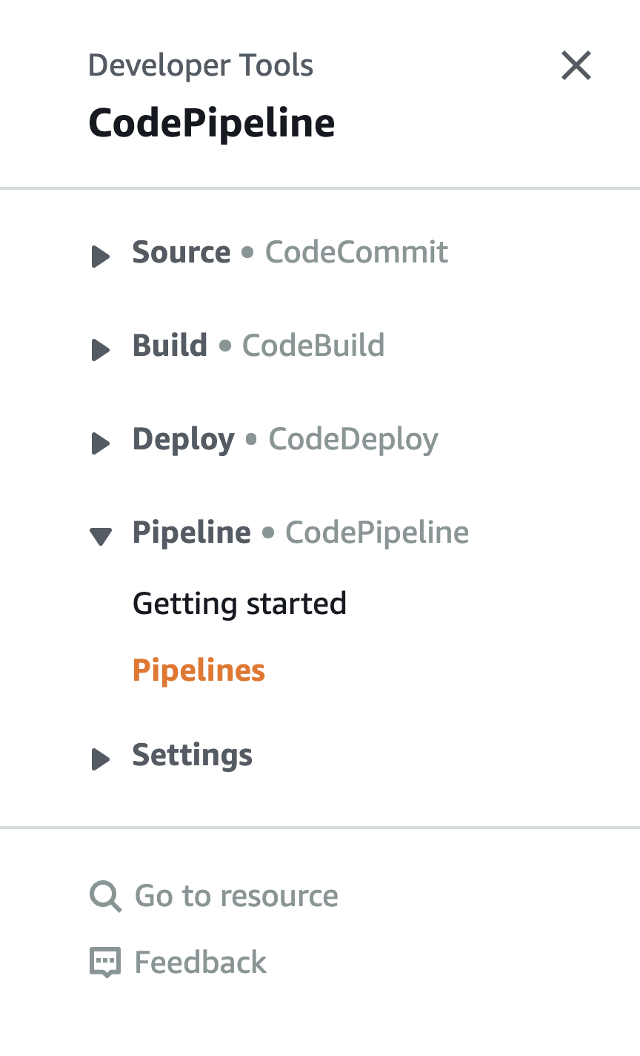
Introduction to AWS Code Pipelines
CodePipelines use elements
CodeCommit (version control system, ≈ git)
CodeBuild (compiles source code, runs tests, and produces software packages that are ready to deploy)
CodeDeploy (automates software deployments to a variety of compute services such as EC2, Fargate, Lambda, and on-premises servers)
Pipepline combines these elements

Slide 3
CodeBuild uses buildspec.yml
A buildspec is a collection of build commands and related settings, in YAML format, that CodeBuild uses to run a build.

Slide 4
Buildspec simplified
https://docs.aws.amazon.com/codebuild/latest/userguide/build-spec-ref.html
A buildspec
defines the build environment and
The commands to take out
Only the following build steps are available:
install
pre_build
build
post_build
A build often has a(n) artifact(s)
version: 0.2
run-as: Linux-user-name
env:
variables:
…
phases:
install:
commands:
- command(s)
pre_build:
commands:
- command(s)
build:
commands:
- command(s)
post_build:
commands:
- command(s)
artifacts:
files:
- location
← Smart Check here

Slide 5
Smart Check in buildspec.yml
post_build:
commands:
- >-
docker run -v /var/run/docker.sock:/var/run/docker.sock
deepsecurity/smartcheck-scan-action
--image-name "$REPOSITORY_URL:$TAG"
--findings-threshold "{\"malware\":0,\"vulnerabilities\”…}}"
--preregistry-host="$PRE_SCAN_REPOSITORY"
--smartcheck-host="$SMARTCHECK_HOST"
--smartcheck-user="$SMARTCHECK_USER"
--smartcheck-password="$SMARTCHECK_PWD"
--insecure-skip-tls-verify
--preregistry-scan
--preregistry-user "$PRE_SCAN_USER"
--preregistry-password "$PRE_SCAN_PWD"
- $(aws ecr get-login --no-include-email)
- docker push $REPOSITORY_URL:$TAG
← Smart Check here
← Push to ECR here

Slide 6
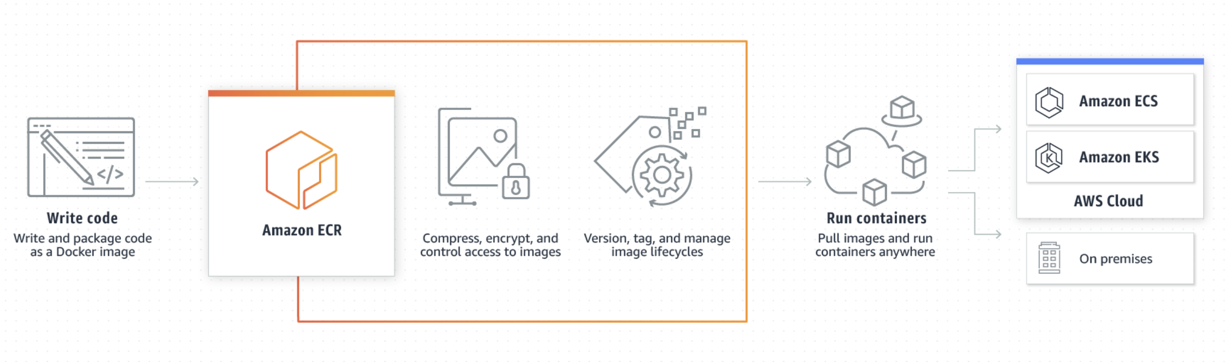
Elastic Container Registry (ECR)
ECR is a fully-managed container registry
Supports image scanning on push

Slide 7
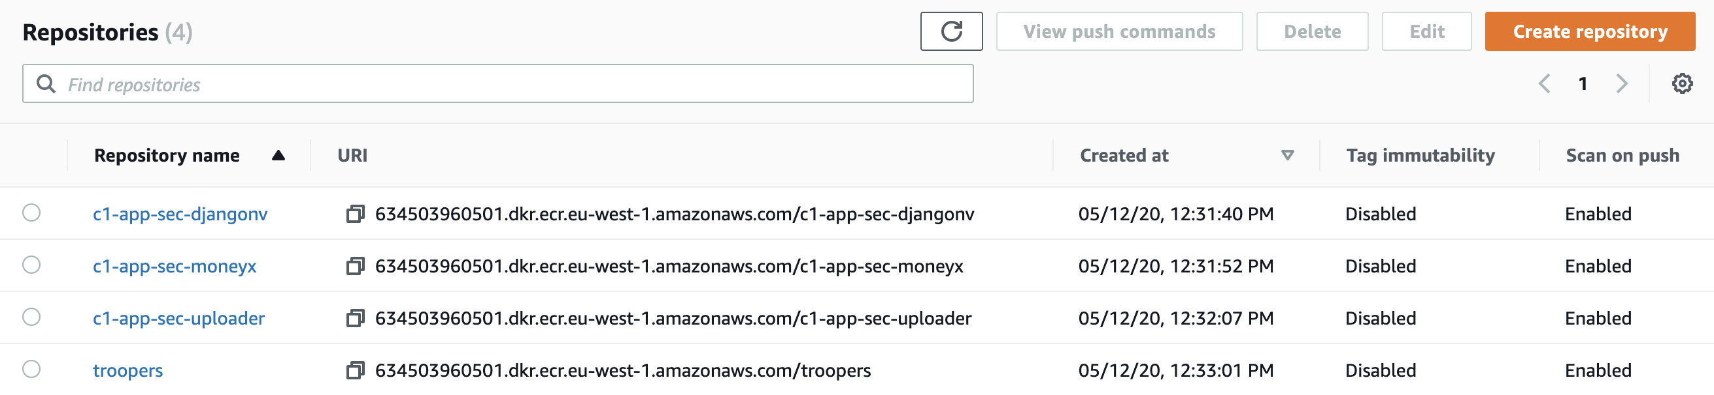
ECR Scan on Push
ECR uses Clair = not charged
Reporting by GUI or boto3

Slide 8
